Slide 1

SECTION NAME

Slide 2
Agenda
01.
02.
03.
04.
05.
06.
Intro
Why do we test?
What do we test?
How do we test?
Who does the testing?
Summary

Slide 3
Intro

Slide 4
Why do we test?

Slide 5
“Always code as if the person who ends up maintaining your code will be a violent psychopath who knows where you live.”
Notes:
Maintainability of code

Slide 6
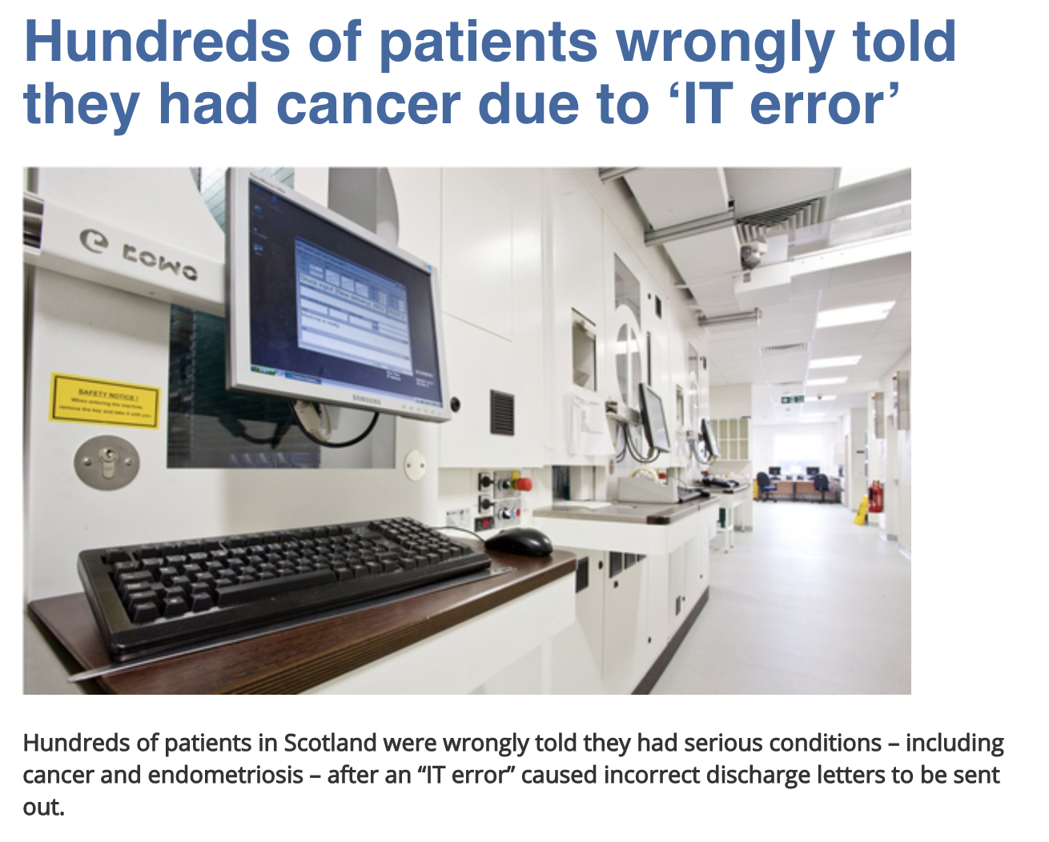
Notes:
Testing is not only about the checking the right behaviour of a system, but also about the faulty behaviour.

Slide 7
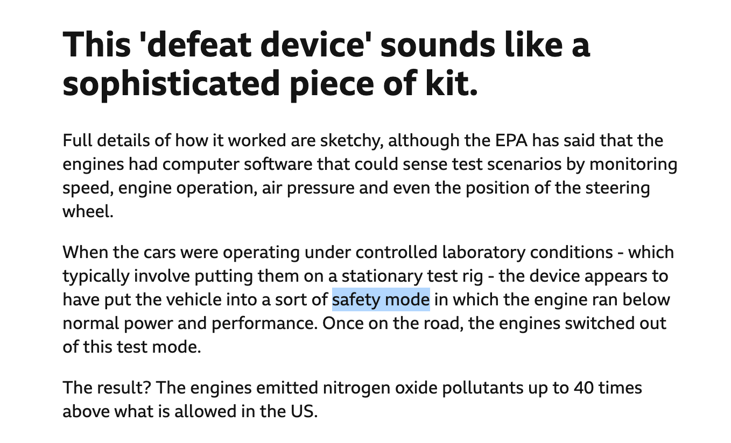
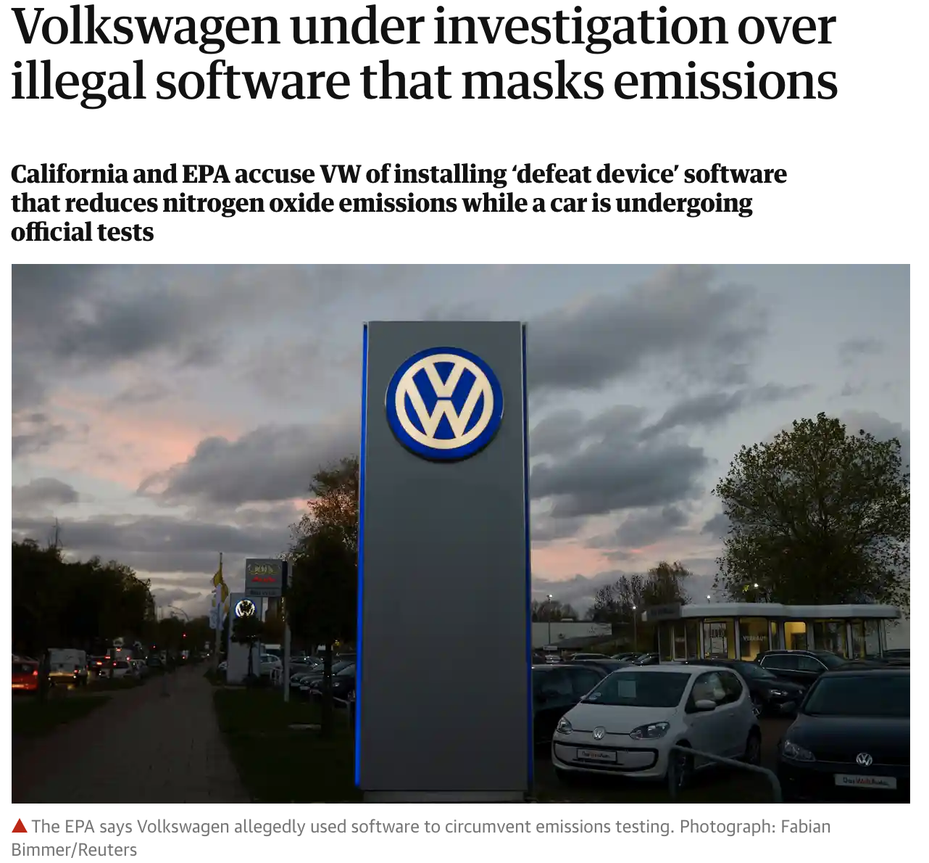
Notes:
Testing requires a good understanding of system, including the requirements.

Slide 8

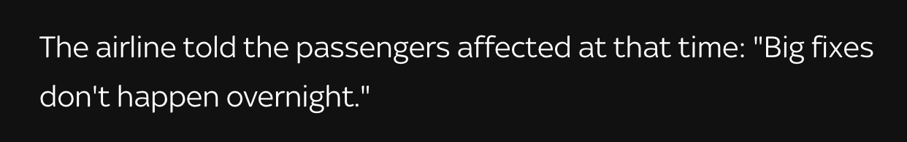
Notes:
Testing is about reducing the risk - to customers, monetary and reputational

Slide 9

Quiz time!
https://forms.gle/sPxFHWjzGbNEM5EQ8

Slide 10
What do we test?

Slide 11
Different Types Of Software Testing
Unit Testing: validating a unit of code in isolation
Integration Testing: validating different units, modules or components of a software application as a combined entity
System Testing: validating the various components of an application interact together in the full, integrated system or application
Sanity Testing: ensuring that the changes introduced into the system are working as expected
Smoke Testing: verifying that the most important functionalities of system are working
Interface Testing: validating the interaction between the two systems or applications that are involved in the software application
Regression Testing: ensuring an application still functions as expected after any code changes, updates, or improvements
Performance Testing
Security/Pen Testing
Beta/Acceptance Testing
Notes:
Sanity and Smoke testing differences:
Smoke Testing has a goal to verify “stability” whereas Sanity Testing has a goal to verify “rationality”.
Smoke Testing is done by both developers or testers whereas Sanity Testing is done by testers.
Smoke Testing verifies the critical functionalities of the system whereas Sanity Testing verifies the new functionality like bug fixes.
Smoke testing is a subset of acceptance testing whereas Sanity testing is a subset of Regression Testing.
Smoke testing is documented or scripted whereas Sanity testing isn’t.
Smoke testing verifies the entire system from end to end whereas Sanity Testing verifies only a particular component.

Slide 12
Different Types Of Software Testing
Unit Testing
Integration Testing
System Testing
Notes:
Let’s take a look at the first three types for this presentation.

Slide 13
Test Pyramid
UI
Service
Unit
Ref.: Martin Fowler’s TestPyramid article (https://martinfowler.com/bliki/TestPyramid.html)

Slide 14
Basic Application design
Application
Service/API
Database

Slide 15
Common application design in practice(Database-per-service pattern)
Application
Service/API
Service/API
Service/API
Database
Database
Database

Slide 16
Common application design in practice(Shared-database-per-service pattern)
Application
Application
Application
Service/API
Service/API
Service/API
Database

Slide 17
Microservice architecture pattern
Application
Service/API
Service/API
Service/API
Service/API
Service/API
Service/API
Database

Slide 18
A different approach
Notes:
Instead of concentrating on the technical aspects, we are going to approach the testing from a feature point of view

Slide 19
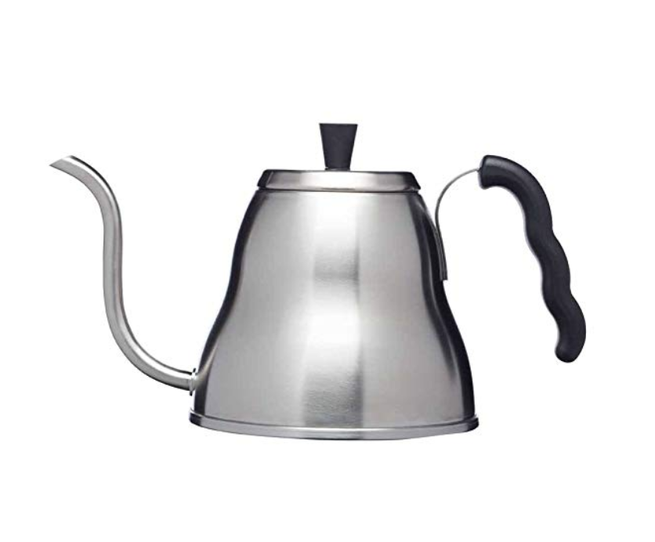
Kettle A
Primary function: boiling water
Extra long spout for accurate pouring
Needs external heat source to function
Made from metal, some plastic bits

Slide 20

Kettle B
Primary function: boiling water
Extra: can see water level
Made from plastic mostly, has metal parts
Two pieces: kettle and base station
Uses electricity
On/off switch

Slide 21

Kettle C
Primary function: boiling water
Extra: can heat water to specific temperatures
Extra: LED light (wow!)
Made from glass, metal and plastic
Two pieces
Uses electricity
On/Off switch is on the base station (or is it?)

Slide 22
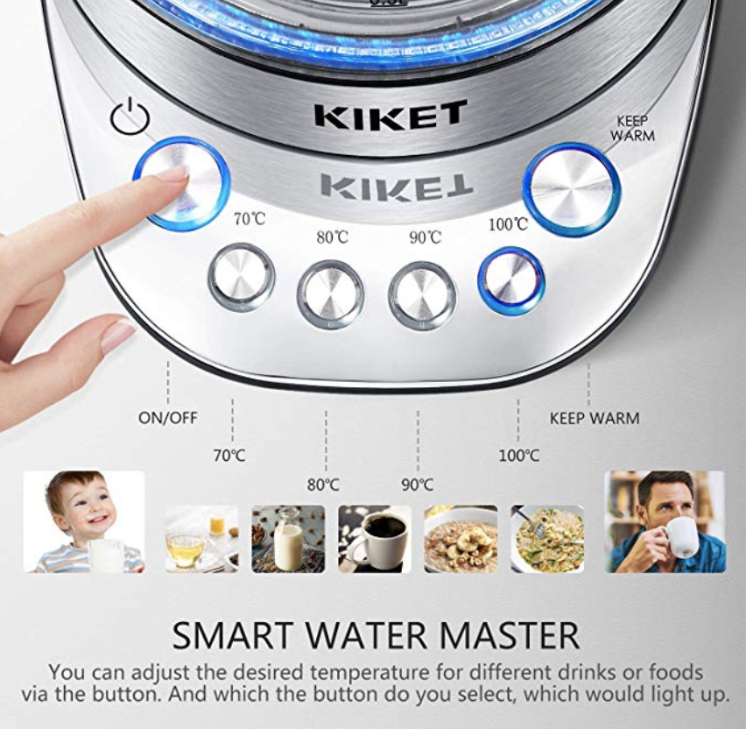
Not a kettle
No On/Off switch on Kettle
Buttons for 4 different water temperatures
Keep warm button
LED lights everywhere

Slide 23
Quiz time!
https://forms.gle/axYahfMrtGLGtP4x7

Slide 24
How do we test?

Slide 25
E2E/System
Integration
Unit

Slide 27
Unit testing is a type of testing which is done by software developers in which the smallest testable module of an application - like functions, procedures or interfaces - are tested to ascertain if they are fit to use.

Slide 28



E2E
Integration
Unit
Notes:
For the kettle, the elements used to build the kettle are smallest possible so can be tested in isolation

Slide 29
Given: The metal is hot. When: I hit it with a hammer. Then: I can hit it 5 times before it starts to deform.

Slide 30
Integration testing is a software testing methodology used to test individual software components or units of code to verify interaction between various software components and detect interface defects.

Slide 31

E2E
Integration
Unit
Notes:
Integration of different components together (the elements that make up the handle)

Slide 32
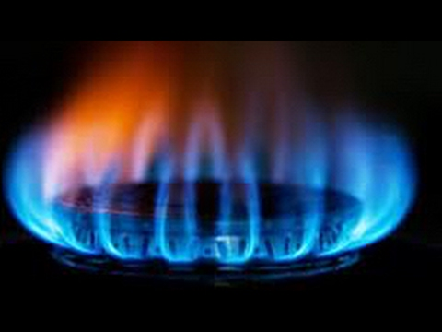
E2E
Integration
Unit
Notes:
Interactions with other systems (i.e. the heater)

Slide 33
Given: The spout is attached to the body. When: I apply force that pulls the spout away from the body. Then: The force pulling needs to be more than x before the spout rips off.

Slide 34

E2E
Integration
Unit

Slide 35
E2E
Integration
Unit

Slide 36
End-to-end testing is a methodology used to test whether the flow of an application is performing as designed from start to finish.

Slide 37

E2E
Integration
Unit

Slide 38
Given: The kettle is filled with water to the top, and the lid is put on. When: I put it on a heat source and bring it to the boil. Then: The boiling water will not push the lid off the kettle.

Slide 39
5 unit tests
2 integration tests
1 E2E tests
Notes:
https://jamboard.google.com/d/1D2Xg6NOU3dZYfagezxq2S0J9WvfuojDN0bRTvue9uXk/edit?usp=sharing
Let’s write unit, integration and E2E tests in groups Unit test: tests the smallest testable unit or module. Example: Given the metal is hot, when I hit it with a hammer then it takes at least 5 blows before it's shape changes.
Integration test: Tests the interface between two components. Example: Given the spout is attached to the body of the kettle, when I run water through the spout then there is no dripping where the two meet.
End-to-End test: Tests the full user flow. Example: Given I have filled the kettle with water, when I push the "on" button then the kettle starts heating the water.

Slide 40
Who does the testing?

Slide 41






What is testing?
Finding defects is a CONSEQUENCE of testing
Information helps decision making
Builds confidence
If it doesn’t add value don’t do it.
Finding defects
Information gathering
Tick box exercise
It’s the responsibility of the the entire team
to care for quality. You can’t test quality into a product.
Learn about your product, know how it behaves.
Decrease risk.
Assuring quality
Learning
Notes:
Before we answer that question, I want to speak a little bit about the expectations we have what testing is and what it provides.

Slide 42
No really - WHO does the testing??

Slide 43
Who does the testing?
Tester
Test strategy
Test harness
Automated regression tests
Exploratory testing
E2E tests
Performance tests
System monitoring
Acceptance tests
Design review
User Acceptance Testing
User feedback
Developer
Unit tests
Integration tests
Automated regression tests
E2E tests
Performance tests
System monitoring
PO/PM/BA (Product)
Acceptance tests
Design review
User feedback
System monitoring
Users
User Acceptance Testing
A/B testing
User feedback
Notes:
So who does the testing.
Developers, do a whole lot of testing in fact arguably most of it. Developers will be writing a whole bunch of unit tests, integration tests.
These tests will form the automated regression packs that will get ran all the time to check your product is still working as intended.
They will also be involved in writing automated e2e tests.
You may have a specialized person on your team writing performance tests but if not, then this will likely be the developer too.
System Monitoring - this is not always classed under test activities but I feel that it is or at least supports it. Often tests you run will have an impact on your entire system but you will not know about your entire system if you do not monitor it. So system monitoring is very important in learning how you system is reacting to different conditions etc.

Slide 44
Quiz time!
https://forms.gle/bceKEE3uG3qVtDac9

Slide 45
Summary

Slide 46
Testing is done by the entire team
Testing provides information about your application, or the SUT (system under test)
We do as much testing as needed to be confident that our code works as expected
Think outside the box
Talk to each other
Go forth and break things!

Slide 47
Thank you

